Slide 1
Astro 331
Spacecraft Manufacturing and Reliability
SMAD Ch 19, Supp Crs Mtl

Slide 2
Lesson Objectives
Describe what screening means with respect to parts selection
Explain the bathtub curve and why it is relevant to spacecraft design
Describe various types of redundancy and what types of faults they protect against
Understand what a Failure Modes, Effects, and Criticality Analysis (FMECA) is and the benefits of performing it
Explain the relationship between reliability (success) and failure
Perform basic reliability block diagram reduction (using series, parallel, and combinations)

Slide 3
Definitions
Basic Reliability: probability that a device will function without failure of any kind over a specified time period of amount of usage
Mission Reliability: probability that a system will function without mission failure over a specified time period
*Note the difference: “without failure of any kind” vs “without mission failure”
It is also implied that reliability is only valid if the device is being operated as intended (ie, within specified temperatures, loads, etc)

Slide 4
Parts Selection
Every part will eventually fail – it’s a question of when
Parts selection needs to consider producibility, radiation, out-gassing, and other application-specific requirements

Slide 5
Parts Screening
Parts screening is a process that eliminates units that have a higher likelihood of failing in service than the other units in the lot
Reduces the probability of failure by rejecting the lower tail of the distribution
Costs: loss of rejected parts plus cost of testing
Examples: vibration, thermal, x-rays, destructive physical analysis

Slide 6
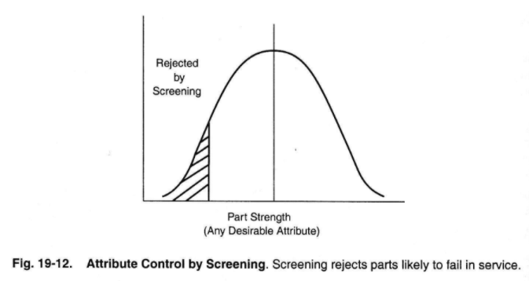
Parts Screening

Slide 7
Process Control
Better process control measures during parts manufacturing can help parts to perform closer to desired mean performance
Parts derating is operating a part at less than its maximum capacity to extend the lifetime of the part (this is common)
Reduces the probability of failure by moving the average reliability of the parts higher

Slide 8
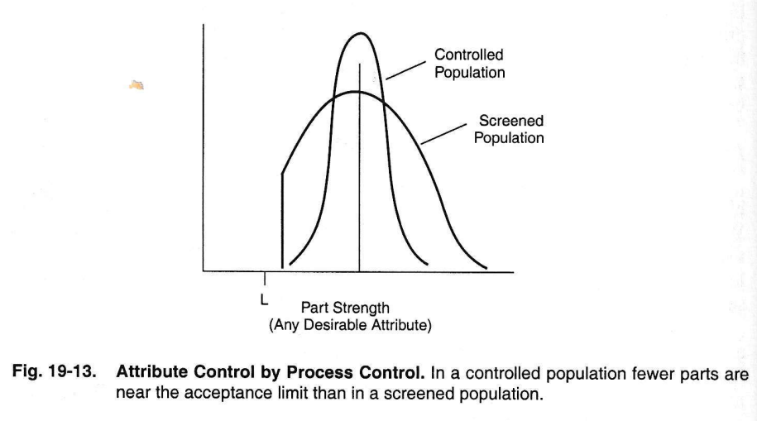
Process Control

Slide 9
Parts Failure
Failure rates are high initially due to random manufacturing defects (infant mortality)
After defective parts are weeded out, fairly constant failure rate (failures are random, but on average at a consistent rate)
Failure rates rise again toward end of life (wear-out)
This is called the “bathtub” curve

Slide 10
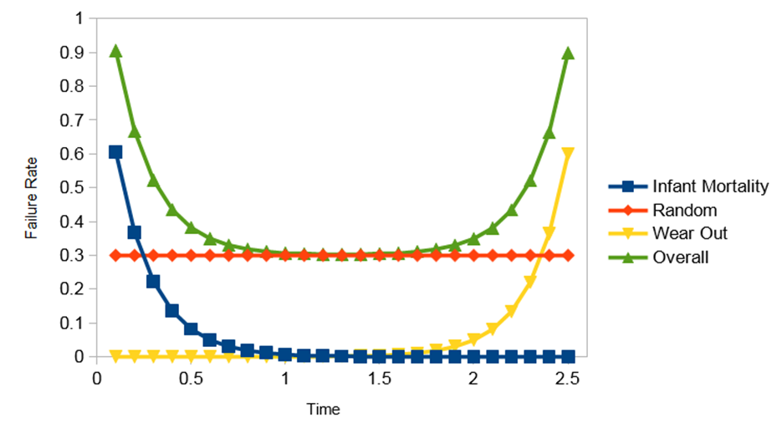
“Bathtub” Curve

Slide 11
Redundancy
Having multiple methods to carry out a function, should the primary method fail
Same Design Redundancy: two or more identical components with switching to allow either to be active at a time
K-out-of-N Redundancy: pool of identical components can be assigned to replace any one of the pool of active units
Diverse Design Redundancy: two or more components of a different design to accomplish the same function
Functional Redundancy: having multiple methods of accomplishing the same function, either with multiple components or multiple combinations of components (ie: omni-directional antenna along with parabolic dish)
Temporal Redundancy: repetition of an unsuccessful operation (acquiring a star, firing of a pyrotechnic device, trying to communicate with the ground)

Slide 12
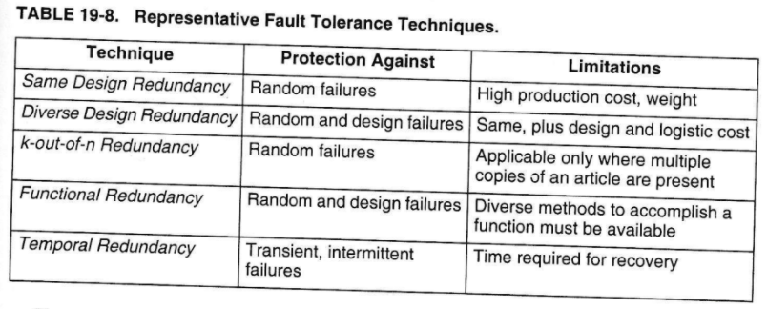
Types of Redundancy

Slide 13
FMECAs (Failure Modes, Effects and Criticality Analysis)
Assessment of probability of failure of each unit/function in a component/subsystem/system
Includes probability of each failure that cause a given effect (ie, transponder not working – could be any of a set of lower-level functions that have failed)
Benefit: if (when) an anomaly occurs, this is a good guide to use to narrow down most likely causes of failure

Slide 14
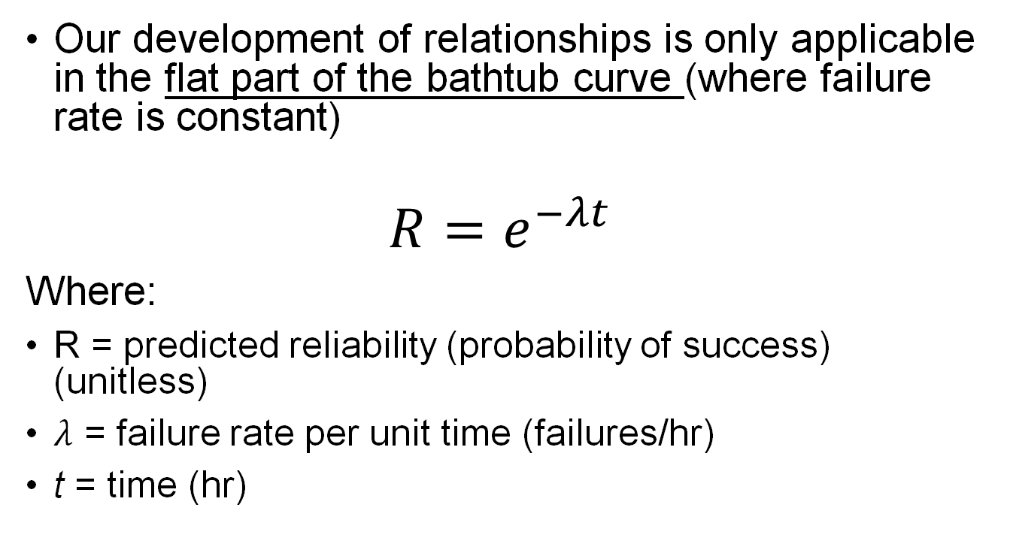
Reliability Basic Math (1/2)
Our development of relationships is only applicable in the flat part of the bathtub curve (where failure rate is constant)
$$R=e^{−λt}$$
Where:
R = predicted reliability (probability of success) (unitless)
$λ$ = failure rate per unit time (failures/hr)
t = time (hr)

Slide 15
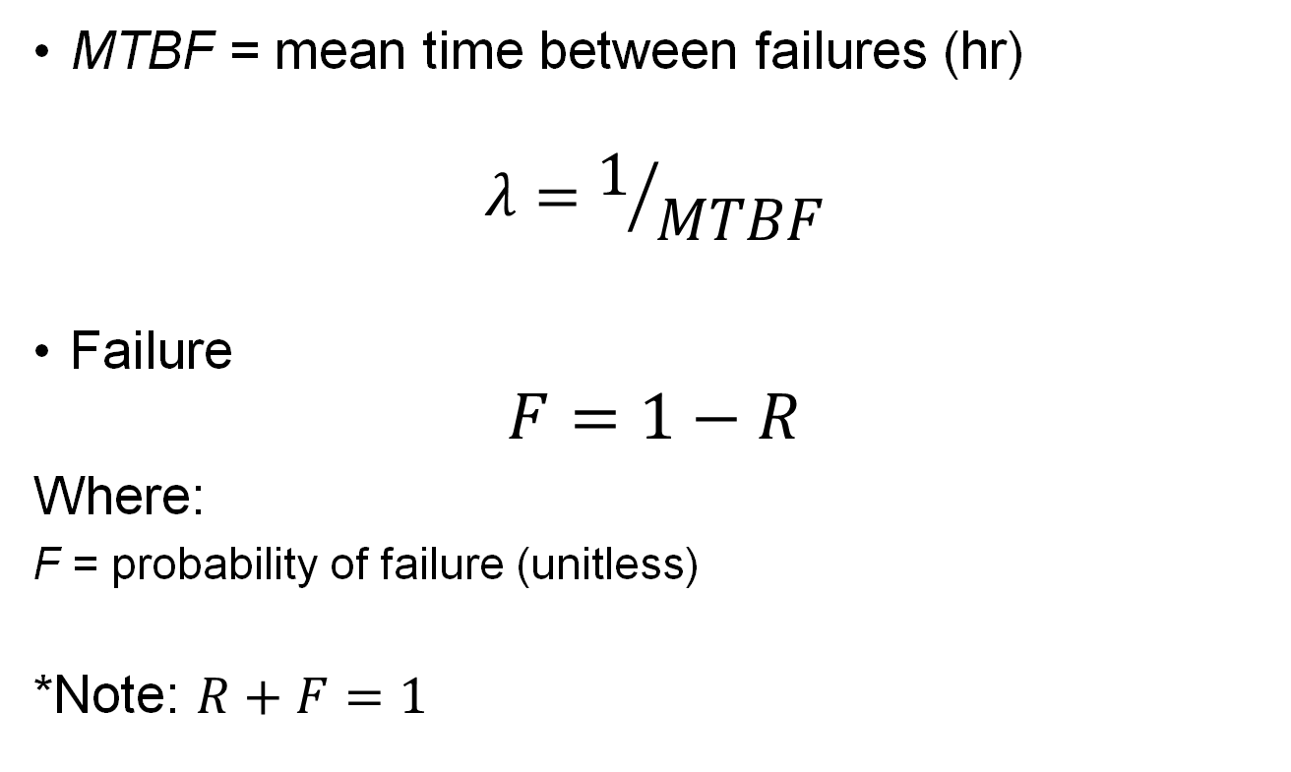
Reliability Basic Math (2/2)
MTBF = mean time between failures (hr)
$$λ=1/{MTBF}$$
Failure
$$F=1−R$$
Where:
F = probability of failure (unitless)
*Note: $R+F=1$

Slide 16

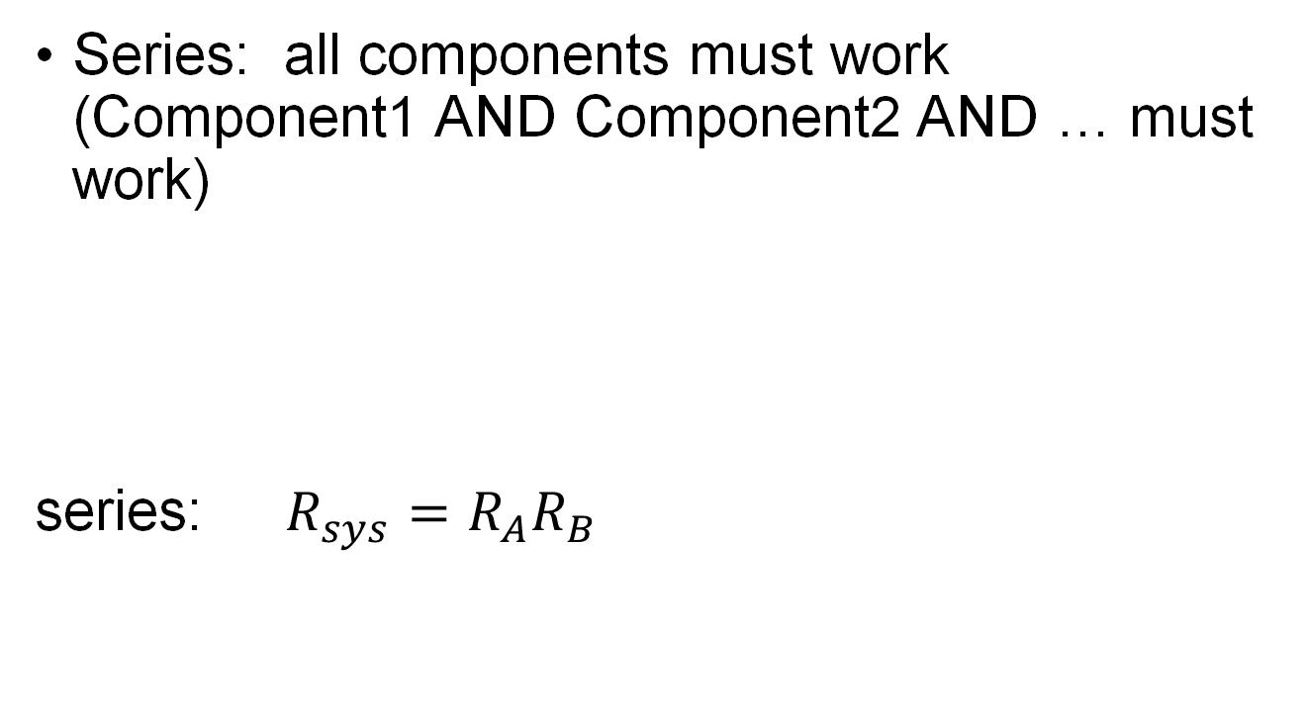
Reliability Block Diagrams (1/2)
Series: all components must work (Component1 AND Component2 AND … must work)
series: $R_{sys}=R_{A}R_{B}$

Slide 17
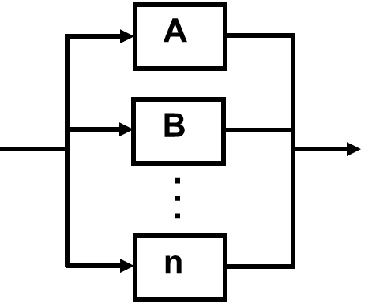

Reliability Block Diagrams (2/2)
Parallel: only ONE component must work (Component1 OR Component2 OR … must work)
parallel: $R_{sys}=1−\left[\left(1−R_{A}\right)\left(1−R_{B}\right)\right]$

Slide 18
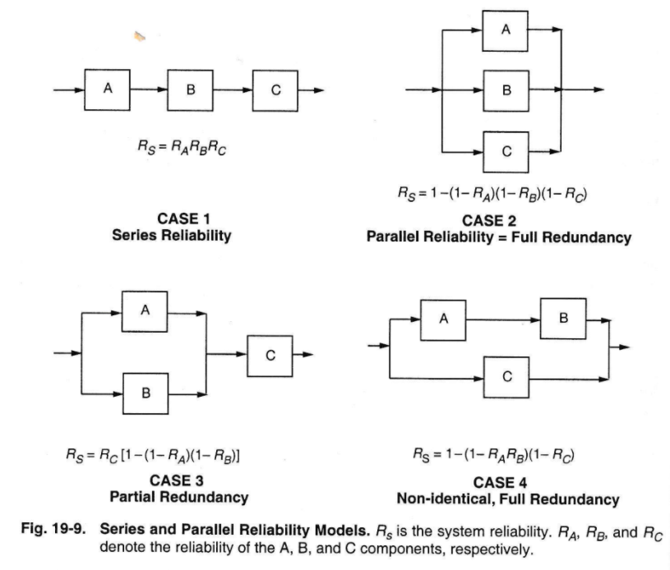

Slide 19
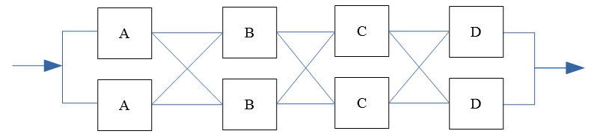
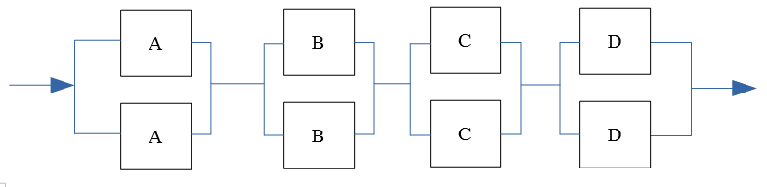
Common S/C Redundancy (2/2)
Cross-Strapping (aka partitioned redundancy)
Two parallel paths where components are connected in parallel
Allows for swapping of any one component, rather than an entire “string” in case of failure
Which, through block diagram reduction, reduces to:

Slide 20
Reliability Block Diagram Reduction
Look for ways to combine blocks to simplify diagram to a single block

Slide 21
Effects of Reliability

Slide 24
Example
Given: Block diagram & component reliabilities
Find: System reliability

Slide 25
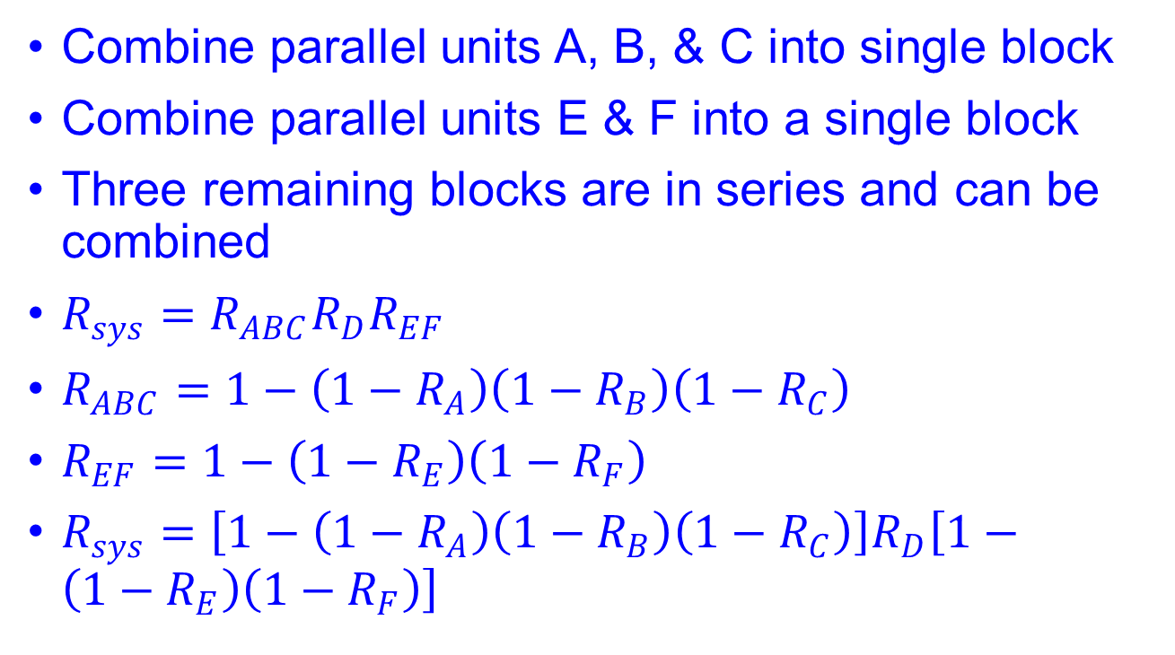
Solution
Combine parallel units A, B, & C into single block
Combine parallel units E & F into a single block
Three remaining blocks are in series and can be combined
$R_{sys}=R_{ABC}R_{D}R_{EF}$
$R_{ABC}=1−\left({1−R}_{A}\right)\left({1−R}_{B}\right)\left({1−R}_{C}\right)$
$R_{EF}=1−\left({1−R}_{E}\right)\left({1−R}_{F}\right)$
$R_{sys}=\left[1−\left({1−R}_{A}\right)\left({1−R}_{B}\right)\left({1−R}_{C}\right)\right]R_{D}\left[1−\left({1−R}_{E}\right)\left({1−R}_{F}\right)\right]$

